Slide 1
Simplifying Non-Simple Fan-Planar Drawings
Boris Klemz, Kristin Knorr, Meghana M. Reddy, Felix Schröder
Meghana M. Reddy
meghana.mreddy@inf.ethz.ch
D-INFK, ETH Zürich
September 15, 2021

Slide 2
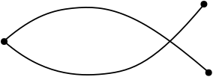
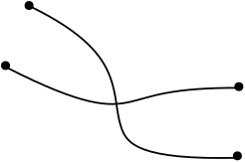
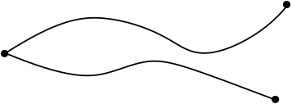
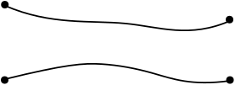
Simple Topological Drawings
Any two edges have at most one point in common, including endpoints.
X
X
X
X

Slide 3
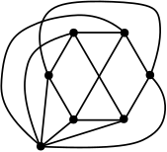
Near-Planar Graphs
Planar graphs: Graphs that have a drawing where no edge is crossed.
Near-Planar graphs: Non-planar graphs with topological constraints
Specific types of crossings
Number of crossings
Forbidden crossing patterns
k-planar graphs
k-quasi-planar graphs
RAC graphs
X
Fan-planar graphs
2-planar
3-quasi-planar

Slide 4
Fan-Planar Graphs
Fan-Planar drawing: All the edges crossing an edge $e$ are incident to a common vertex, and this vertex lies on the same side of the edge $e$.
X
“Special vertex”
Forbidden configurations

Slide 5
Simple Fan-Planar Graphs
Introduced by Kaufmann and Ueckerdt in 2014.
Recognizing fan-planar graphs is NP-hard [Binucci et al., 2015], also in the fixed rotation system setting [Bekos et al., 2017].
Maximal outer-fan-planar graphs can be recognized in polynomial time [Bekos et al., 2017].
simple fan-planarity $⊆$ simple 3-quasiplanarity
Non-simple drawing

Slide 6
Non-Simple Fan-Planar Graphs
X
Non-simple fan-planarity vs non-simple 3-quasiplanarity?
Can every non-simple fan-planar drawing be redrawn as a simple fan-planar drawing of the same graph?
Yes!

Slide 7
Simplifying using elementary methods
Exchange operation
Reroute operation
Not fan-planar anymore
Not fan-planar anymore

Slide 8
Algorithm for Simplifying
Component 1
Component 2
Component 3

Slide 9
Algorithm for Simplifying
Adjacent crossings
where special vertex is incident to the edge
Component 2
x
Component 3

Slide 10
Algorithm for Simplifying
Adjacent crossings
where special vertex is incident to the edge
Edges which cross more than once
Component 3

Slide 11
Algorithm for Simplifying
Adjacent crossings
where special vertex is incident to the edge
Edges which cross more than once
Adjacent crossings
where special vertex is not incident to the edge

Slide 12
Algorithm for Simplifying
Adjacent crossings
where special vertex is incident to the edge
Edges which cross more than once
Adjacent crossings
where special vertex is not incident to the edge

Slide 13
Conclusion
Any non-simple fan-planar drawing can be redrawn into a simple fan-planar drawing of the same graph.
All the results and algorithms for edge density and recognition of simple fan-planar graphs follow for non-simple fan-planar graphs as well.
Can a non-simple fan-planar drawing be redrawn into a a simple fan-planar drawing when the rotation system is fixed?
Thank you!

Slide 14
Algorithm for Simplifying
Adjacent crossings
where special vertex is incident to the edge
Component 2
x
Component 3

Slide 15
Algorithm for Simplifying
Adjacent crossings
where special vertex is incident to the edge
Edges which cross more than once
x
x
x
Component 3

Slide 16
Algorithm for Simplifying
Adjacent crossings
where special vertex is incident to the edge
Edges which cross more than once
Adjacent crossings
where special vertex is not incident to the edge

Slide 17
Algorithm for Simplifying
Adjacent crossings
where special vertex is incident to the edge
Edges which cross more than once
Adjacent crossings
where special vertex is not incident to the edge

Slide 18
Algorithm for Simplifying
Adjacent crossings
where special vertex is incident to the edge
Edges which cross more than once
Adjacent crossings
where special vertex is not incident to the edge

